Slide 1

Fair Chance
Non-profit “last-stretch”
financing for those in need
Bryan Denq • Christopher Denq • Mark Lovett

Slide 2
Problem
Education is expensive; average yearly tuition:
Private non-profit 4 year university: $38k
Public 4 year university: $11k
In 2021, 1.7 trillion dollars of student debt among 45 million debtors
Problems with financial aid:
Federal lending too selective and does not give enough aid
For-profit lending too pricey

Slide 3
Solution
FAIR CHANCE solves this by providing
lower interest rates to more students!

Slide 4








Brand Positioning
Low Interest Rates
High Rejection
Low Rejection
Fair Chance
Competitors (For-profit lenders)
Supplementers (Non-profit lenders)
High Interest Rates

Slide 5
Brand Positioning
Low Interest Rates
We are not replacing FAFSA/non-profit; we are supplementing them by helping under-served students.
We are replacing for-profit lenders.
High Rejection
Low Rejection

Slide 6
The FAIR CHANCE Solution
We invent the FAIR SCORE
Robust, unbiased machine-learning evaluation
Gives holistic understanding of applicants’ stories
Better identify under-served students (vs. FAFSA, non-profits)
We give students the FAIR RATE
Subsidized, deferred interest rate on all non-profit loans given out
Students pay nothing while in school and job search
We only collect repayment once they have a stable income
Removes financial burden short-term → increases success in long-term

Slide 7
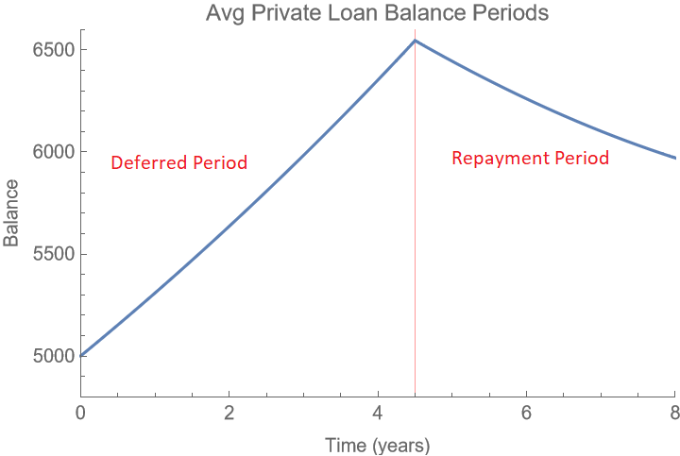
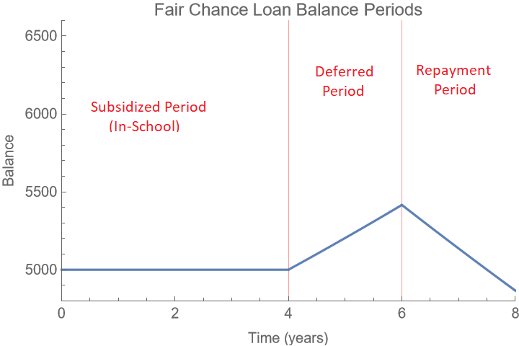
Financials: Loan Structure
Notes:
Subsidized period (In-school) No payments and no interest accumulated
Deferred period (after graduation) No payments but interest starts to accumulate
Repayment period (2 yrs after graduation) Payments start

Slide 8




Call-to-Action: Looking Ahead
Seeking:
Investors, donors, partnerships (Khan Academy, Coursera, Udemy)
Recruiting for:
Legal, Accounting, HR
Applying to:
Coca Cola Foundation
3M Foundation
The Carnegie Foundation
Federal Grants

